Slide 1


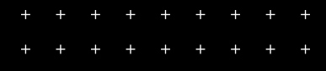
Indian Society for Technical Education

Slide 2
HORIZON’21 | ISTE-VIT
CODE ASYMPTOTE

Slide 3
What will you learn during workshop?
Stacks
Queues
Trees
Hashing
BFS and DFS
Dynamic Programming

Slide 4
What will you learn during workshop?
Stacks
Queues
Trees
Hashing
BFS and DFS
Dynamic Programming

Slide 5
What is Data Structures?
A data structure is a particular way of organizing data in a computer so that it can be used effectively.
More precisely, a data structure is a collection of data values, the relationships among them, and the functions or operations that can be applied to the data.
Data structures provide a means to manage large amounts of data efficiently for uses such as large databases and internet indexing services.
For example, we can store a list of items having the same data-type using the array data structure.

Slide 6
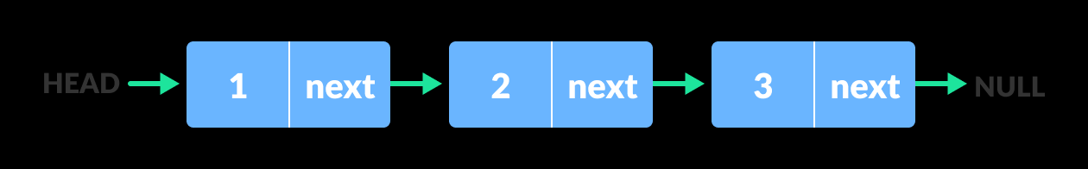
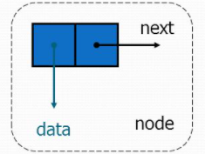
SOME BASIC CONCEPTS
Node
A node is a basic unit of a
data structure, such as a
linked list or tree data structure.
Nodes contain data and also
may link to other nodes.
Links between nodes are often
implemented by pointers.

Slide 7
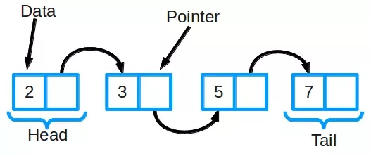
SOME BASIC CONCEPTS
Pointer
A Pointer is a variable that holds the address of another variable.
Advantages of using Pointer:
- It allows to use dynamic memory allocation.
- Helps to return more than one value from function.
- It provide direct access to memory.
- It reduces storage space of program.
- It improve execution speed of program.
Help to build complex data structures such as linked
list, tree, etc.

Slide 8
Let’s start with some basic Data structures!

Slide 9
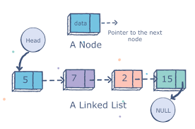
Basic Data Structures
Linked Lists
A linked list is a linear data structure, in which the elements are not stored at contiguous memory locations. The elements in a linked list are linked using pointers.

Slide 10
STACKS

Slide 11
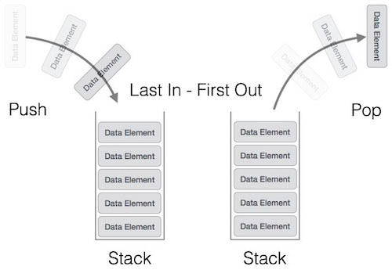
What is a Stack?
A stack is an ordered collection of items where the addition of new items and the removal of existing items always takes place at the same end.It follows the order LIFO(Last In First Out) or FILO(First In Last Out).

Slide 12
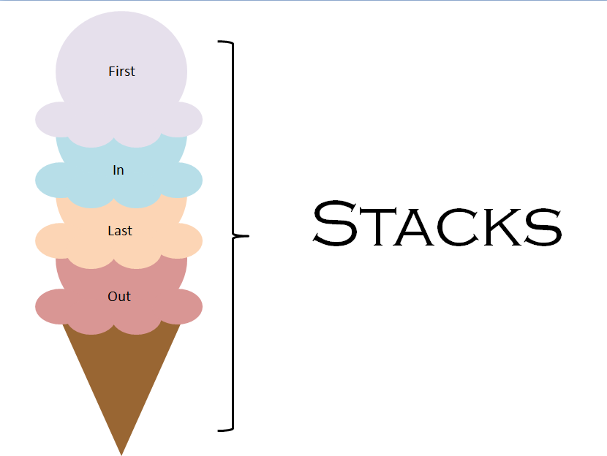
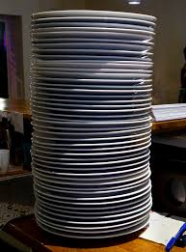
Some Examples of Stacks-

Slide 13
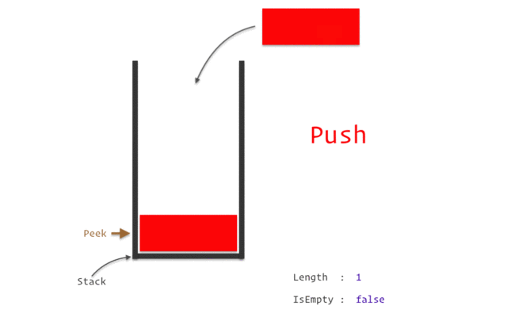
Working of a Stack

Slide 14
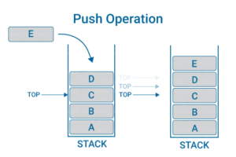
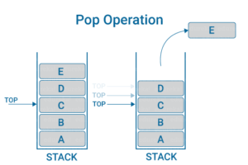
Operations that can be performed on a STACK:
Push
Pop

Slide 15
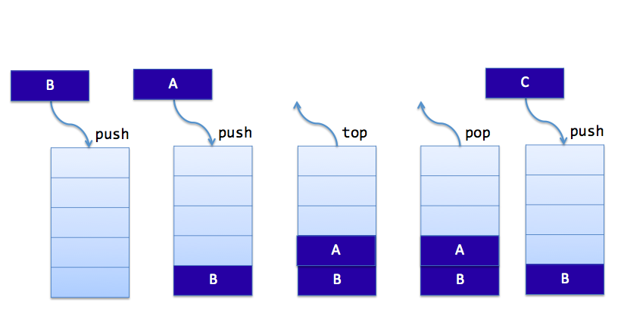
Push : It is used to insert items into the stack.
Pop : It is used to delete items from stack.
Top : It represents the current location of data in stack.

Slide 16
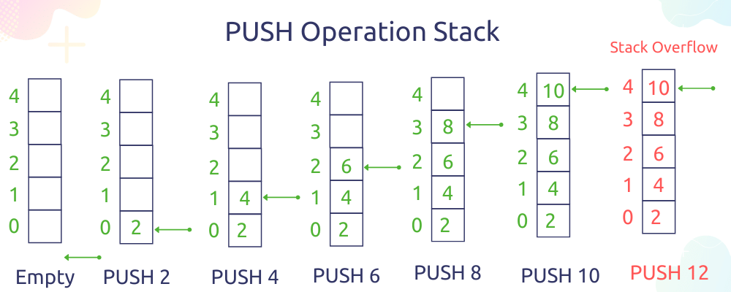
Algorithm Of Insertion In Stack: (Push)
Insertion(a, top, item, max)
If top = max then print ‘ STACK OVERFLOW’ exist
else
top=top+1
end if
a[top] = item
Exit

Slide 17
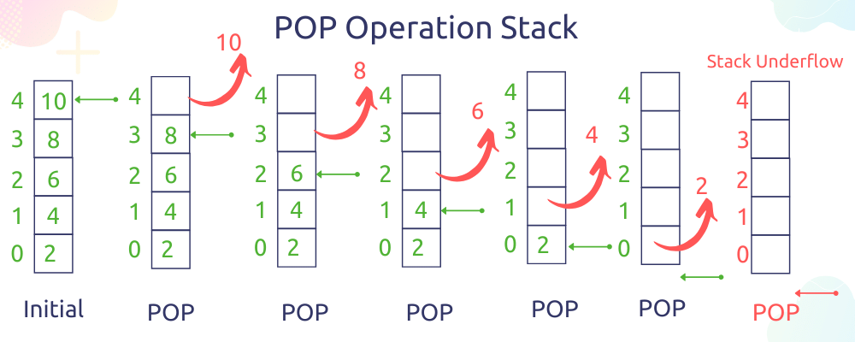
Algorithm Of Deletion In Stack: (Pop)
Deletion( a, top, item)
If top=0 then print ‘STACK UNDERFLOW’
exit
else
item=a[top]
end if
top=top-1
Exit

Slide 18
Let’s code STACKS!

Slide 19
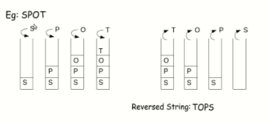
Applications of Stacks are:
Reversing Strings :
A simple application of stack is reversing strings. To reverse a string, the characters of string are pushed onto the stack one by one as the string is read from left to right.
Once all the characters of string are pushed onto stack, they are popped one by one. Since the character last pushed in comes out first, subsequent pop operation results in the reversal of the string.

Slide 20
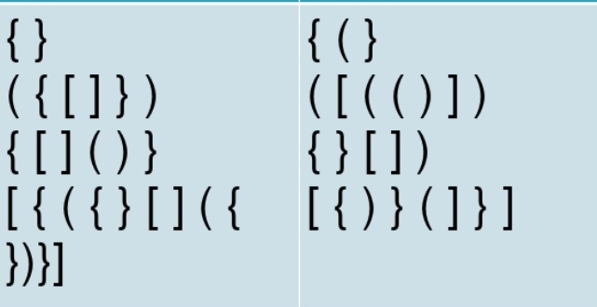
II. Checking the validity of an expression conataining nested parenthesis:
Valid Inputs
Invalid Input
Stacks are also used to check whether a given arithmetic expressions containing nested parenthesis is properly parenthesized.
The program for checking the validity of an expression verifies that for each left parenthesis braces or bracket, there is corresponding closing symbol and symbols are appropriately nested.

Slide 21
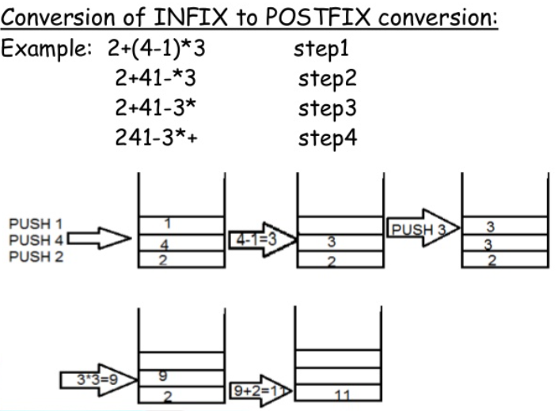
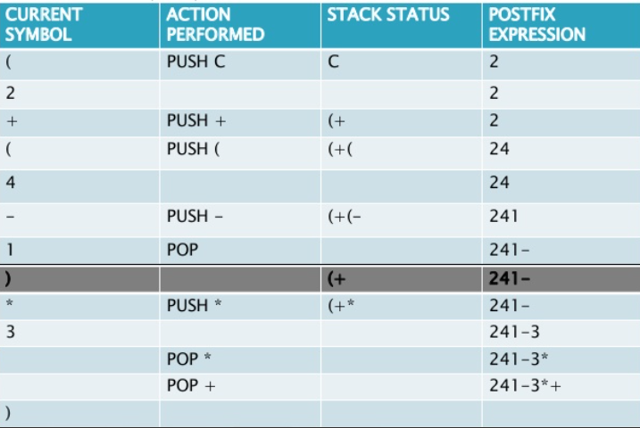
III. Evaluating arithmetic expressions:
INFIX notation:
The general way of writing arithmetic expressions is known as infix notation.
E.g. (a+b)
PREFIX notation:
e.g, +AB
POSTFIX notation:
e.g: AB+

Slide 22
QUEUES

Slide 23
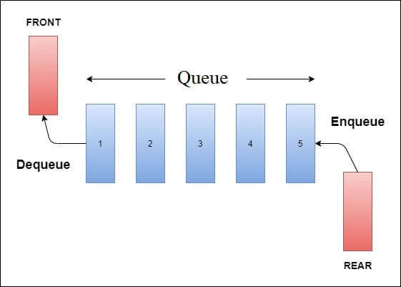
What are Queues?
Queue is an ADT data structures similar to stack, except that the first item to be inserted is the first one to be removed.
This mechanism is called First-in-First-Out (FIFO).
Placing an item in queue is called “insertion or enqueue” , which is done at the end of the queue called “rear”.
Removing an item from queue is called “deletion or dequeue”, which is done at the other end of the queue called “front”.
Some of the applications are : printer queue, keystroke queue, etc.

Slide 24

Representation of Queues
Using an array
2. Using Linked List

Slide 25
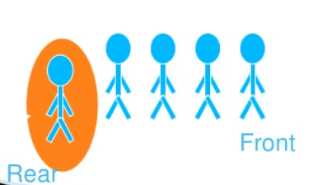
The ENQUEUE Operation
Placing an item in a queue is called “insertion or enqueue”, which is done at the end of the queue called “rear”

Slide 26
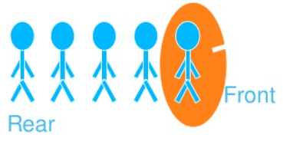
The DEQUEUE Operation
Removing an item in a queue is called “deletion or dequeue”, which is done at the other end of the queue called “front”

Slide 27
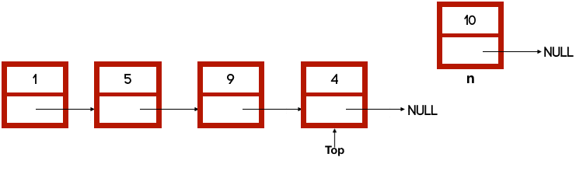
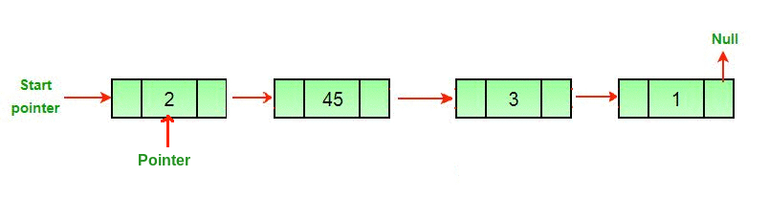
Working of the functions of Queue
Enqueue
Dequeue

Slide 28
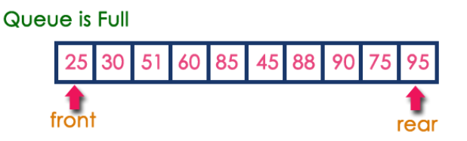
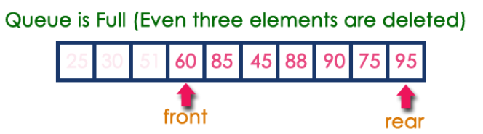
3 states of queues
Queue is empty
FRONT = REAR
Queue is full
REAR = N
Queue contains elements >=1
FRONT < REAR
NO. OF ELEMENT = REAR – FRONT +1

Slide 29
Algorithm QINSERT (IREM)
If (rear = maxsize-1)
print(“queue overflow”) and return
Else
rear = rear + 1
Queue [rear] = item

Slide 30
Algorithm QDELETE ()
If (front = rear)
print(“queue empty”) and return
Else
Front = front+ 1
item = queue[front]
Return item

Slide 31
Let’s code QUEUE!

Slide 32
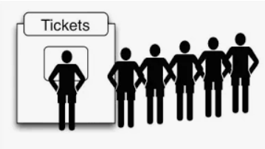
Queue Applications
Real life example
Waiting in line
Waiting on hold for tech support
Applications related to computer science
Round robin scheduling
Job scheduling (FIFO Scheduling)
Key board buffer

Slide 33
TREES

Slide 34
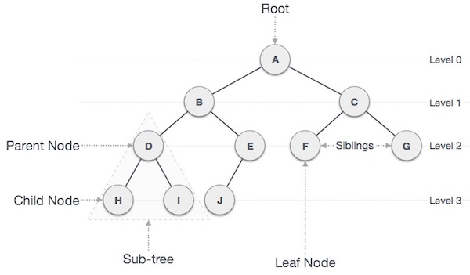
What are TREES?
A tree is a hierarchical data structure defined as a collection of nodes. Nodes represent value and nodes are connected by edges.

Slide 35
Terms used in Trees
In a tree, each node had 0 or more child nodes and each and every node can have at most one parent
Tree with at most two children nodes are termed as binary tree
The node that does not have a parent node is termed as “Root Node”
The node with no child nodes is known as “Leaf Node”.
The nodes which are neither leaf node or root node, are called “Interior Nodes”.
Each and every interior node has both parent node as well as child nodes
The height of the given tree is determined by the distance between the leaf node and root node.
The nodes having same parent node are called “sibling nodes”.

Slide 36
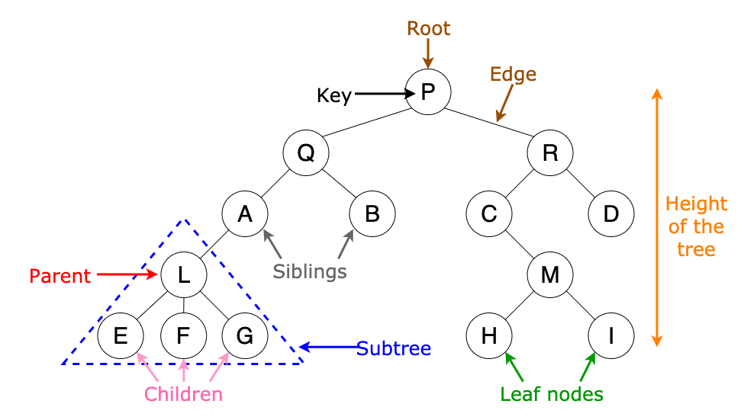
Trees

Slide 37
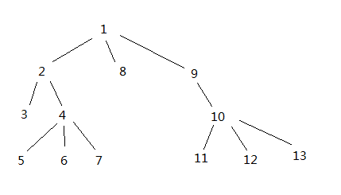
Non-Binary Trees
A non-binary, or multifurcating tree is a tree in which at least one node has more than two children. Such nodes are referred to as polytomies, or non-binary nodes.

Slide 38
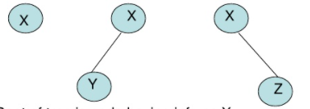
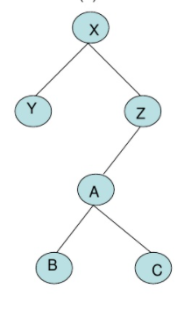
Binary Trees
Special type of tree in which every node or vertex has either no children, one child or two children.
Characteristics :
Every binary tree has a root pointer which points to the start of the tree.
A binary tree can be empty.
It consists of a node called root, a left subtree and right subtree both of which are binary trees themselves.

Slide 39
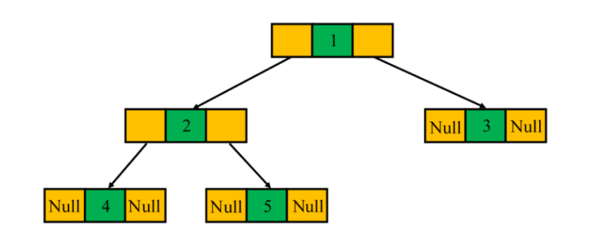
Full Binary Tree
A binary tree is said to be a full binary tree when each internal node has zero or two children.

Slide 40
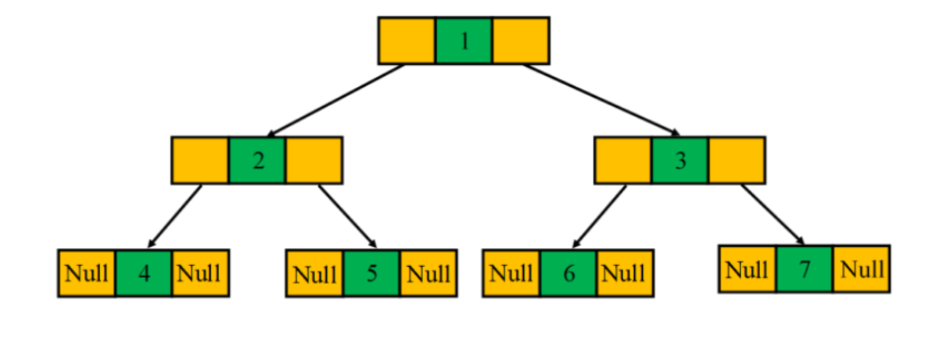
Perfect Binary Tree
A perfect binary tree is a special type of binary tree in which all the leaf nodes are at the same level, and each internal node has two children.

Slide 41
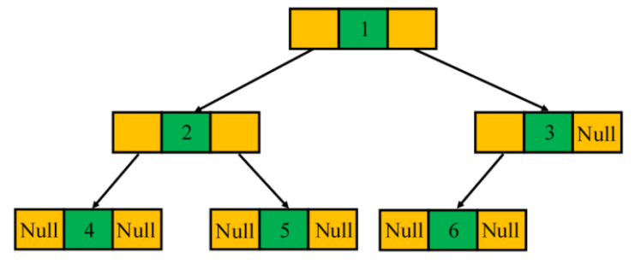
Complete Binary Tree
A binary tree is referred to as a complete binary tree when all of its levels are completely filled. The only exception is possibly the lowest level in which the nodes must lean as left as possible

Slide 42
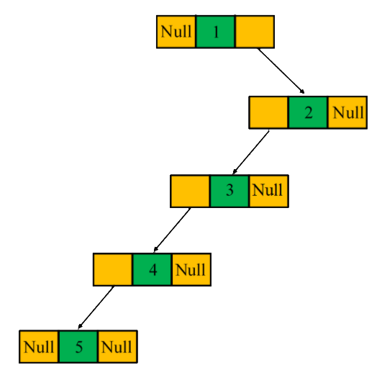
Degenerate Binary Tree
A degenerate or pathological tree is a type of binary tree in which each internal node has a single child, either the left child or the right child

Slide 43
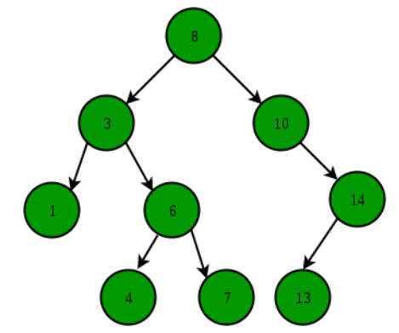
Binary Search Tree
Binary Search Tree is a node-based binary tree data structure which has the following properties:
The left subtree of a node contains only nodes
with keys lesser than the node’s key.
The right subtree of a node contains only
nodes with keys greater than the node’s key.
The left and right subtree each must also be
a binary search tree.

Slide 44
Benefits of using a Binary Tree
An ideal way to go with the hierarchical way of storing data
Reflect structural relationships that exist in the given data set
Make insertion and deletion faster than linked lists and arrays
A flexible way of holding and moving data
Are used to store as many nodes as possible
Are faster than linked lists and slower than arrays when comes to accessing elements

Slide 45
Hash Table, Hashing and Collisions

Slide 46
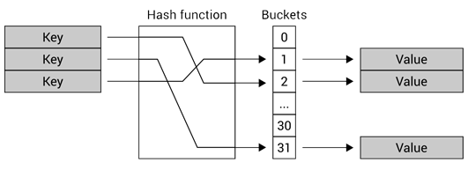
Hash Table
A hash table is a data structure that is used to store keys/value pairs. It uses a hash function to compute an index into an array in which an element will be inserted or searched. By using a good hash function, hashing can work well. Under reasonable assumptions, the average time required to search for an element in a hash table is O(1).

Slide 47
Hashing
Hashing is an important Data Structure which is designed to use a special function called the Hash function which is used to map a given value with a particular key for faster access of elements. The efficiency of mapping depends of the efficiency of the hash function used.
Hashing is the process of mapping large amount of data item to smaller table with the help of hashing function.
Hashing is also known as Hashing Algorithm or Message Digest Function.
It is a technique to convert a range of key values into a range of indexes of an array.
It is used to facilitate the next level searching method when compared with the linear or binary search.
Hashing allows to update and retrieve any data entry in a constant time O(1).
Constant time O(1) means the operation does not depend on the size of the data.
Hashing is used with a database to enable items to be retrieved more quickly.
It is used in the encryption and decryption of digital signatures.

Slide 48
Advantages of Hashing
The main advantage of hash tables over other table data structures is speed.
This advantage is more apparent when the number of entries is large like thousands or more.
Hash tables are particularly efficient when the maximum number of
Entries can be predicted in advance, so that the bucket
Array can be allocated once with the optimum size and never resized.

Slide 49
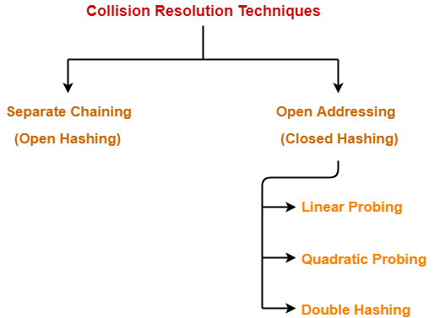
What is collision?
A situation when the resultant hashes for two or more data elements in the data set U, maps to the same location in the hash table, is called a hash collision.
• In such a situation two or more data elements would qualify to be stored/mapped to the same location in the hash table.
There are various methods to solve collisions in hash table.

Slide 50
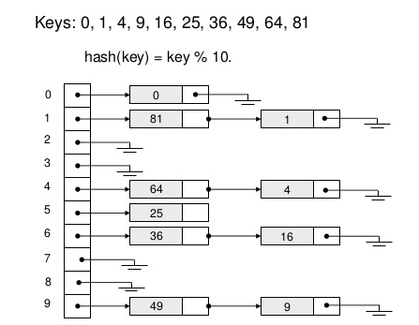
Linear Probing
Linear probing is a simple open-addressing hashing strategy.
To insert an element x, compute h(x) and try to place x there.
If it's full, keep moving through the array,
wrapping around at the end, until a free spot is found.

Slide 51
Linear Probing using Linked List
Separate chaining is one of the most commonly used collision resolution techniques. It is usually implemented using linked lists. In separate chaining, each element of the hash table is a linked list. To store an element in the hash table you must insert it into a specific linked list. If there is any collision (i.e. two different elements have same hash value) then store both the elements in the same linked list.
For separate chaining, the worst-case scenario is when all the entries are inserted into the same linked list. The lookup procedure may have to scan all its entries, so the worst-case cost is proportional to the number (N) of entries in the table.

Slide 52
Searching Algorithms

Slide 53
Why is searching needed?
Searching is the process of finding a particular item in a group of items.
Not even a single day pass, when we don’t have to search for something in our day to day life, like car keys, mobile charger, books etc.,
Same is the life of computer, there is so much data stored in it, that whenever a user asks for some data, computer has to search its memory to look for the data and make it available to the user.
At some or the other point you will face a requirement of search the data from the memory to either process or display it.

Slide 54
Why to use Binary Search Trees?
Searching become very efficient in a binary search tree since, we get a hint at each step, about which sub-tree contains the desired element.
The binary search tree is considered as efficient data structure in compare to arrays and linked lists. In searching process, it removes half sub-tree at every step. Searching for an element in a binary search tree takes O(log₂n) time. In worst case, the time it takes to search an element is O(n).
It also speed up the insertion and deletion operations as compare to that in array and linked list.

Slide 55
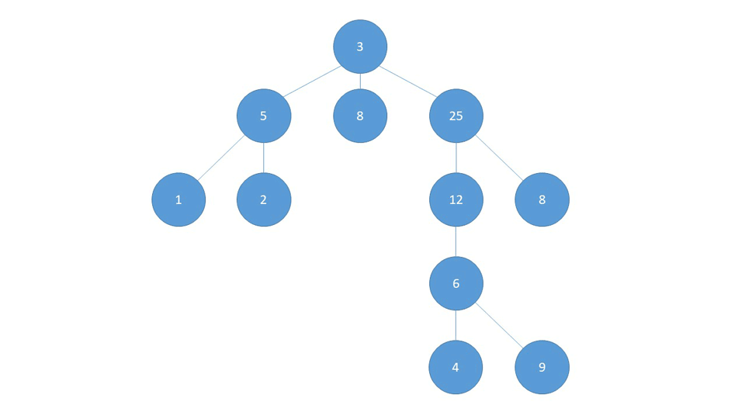
Depth First Search
Approach:
Depth-First Search is an algorithm for traversing or searching a tree.
The algorithm starts at the root node and explores as far as possible along each branch before backtracking.
So the basic idea is to start from the root and move to the adjacent unmarked node and continue this loop until there is no unmarked adjacent node.
Then backtrack and check for other unmarked nodes and finally print element if found.

Slide 56
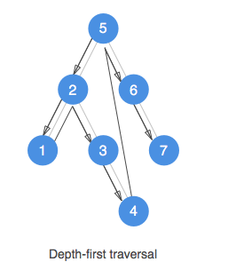
Depth First Search
Algorithm:
Create a recursive function that takes the index of node and the visited array.
Mark the current node as visited.
Traverse all the adjacent and unmarked nodes and call the recursive function with index of adjacent node.

Slide 57
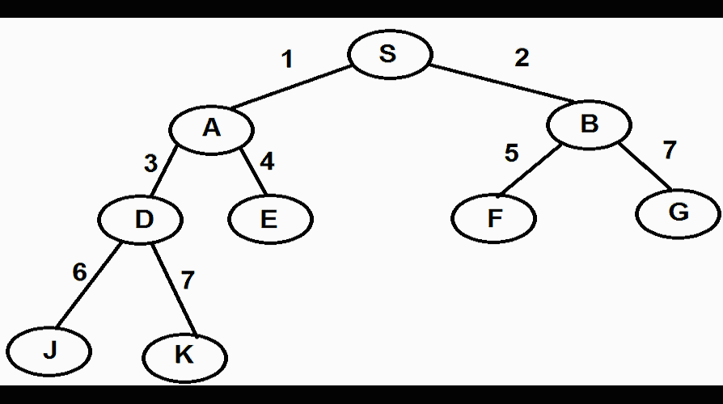
Breadth First search
Approach:
Depth-First Search is an algorithm for traversing or searching a tree.
The algorithm starts at the root node and explores along each level before moving to the next.
So the basic idea is to start from the root and move to the unmarked sibling node and continue this loop until there is no unmarked sibling node and finally print element if found.

Slide 58
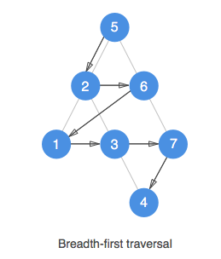
Breadth First search
Algorithm:
Create a recursive function that takes the index of node and the visited array.
Mark the current node as visited and print the node.
Traverse all the unmarked sibling nodes and call the recursive function with index of the next sibling node.

Slide 59
Dynamic Programming

Slide 60
Dynamic Programming
We need to break up a problem into a series of overlapping sub-problems.If we are given a problem, which can be broken down into smaller sub-problems, and these smaller sub-problems can still be broken into smaller ones - and if we manage to find out that there are some over-lappping sub-problems, then we have encountered a DP problem.
The core idea of Dynamic Programming is to avoid repeated work by remembering partial results and this concept finds it application in a lot of real life situations.
In programming, Dynamic Programming is a powerful technique that allows one to solve different types of problems in time O(n²) or O(n³) for which a naive approach would take exponential time.

Slide 61
Fibonacci Series
The Fibonacci sequence, also known as Fibonacci numbers, is defined as the sequence of numbers in which each number in the sequence is equal to the sum of two numbers before it.
The conventional approach to solve Fibonacci series is by pure recursion.

Slide 62
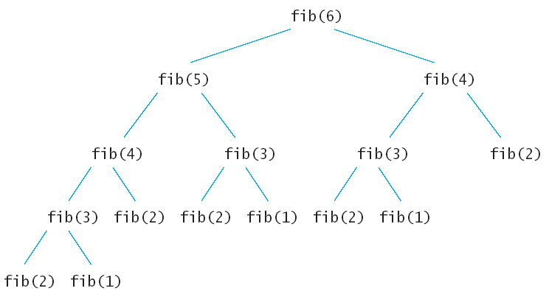
Fibonacci Series
The method to compute the nth element of Fibonacci series, includes the following function:
int fib (int n)
{
if (n < 2)
return 1;
return fib(n-1) + fib(n-2); }

Slide 63
Fibonacci Series
The approach to calculate nth term of Fibonacci series using dynamic programming uses the following function:
void fib ()
{
fibresult[0] = 1;
fibresult[1] = 1;
for (int i = 2; i<n; i++)
fibresult[i] = fibresult[i-1] + fibresult[i-2];
}

Slide 64
Catalan Number

Slide 65
Catalan Numbers
Catalan numbers are a sequence of natural numbers that occurs in many interesting counting problems like following:
The first few Catalan numbers for n = 0, 1, 2, 3, … are 1, 1, 2, 5, 14, 42, 132, 429, 1430, 4862, …
Count the number of expressions containing n pairs of parentheses which are correctly matched. For n = 3, possible expressions are ((())), ()(()), ()()(), (())(), (()()).
Count the number of possible Binary Search Trees with n keys (See this)
Count the number of full binary trees (A rooted binary tree is full if every vertex has either two children or no children) with n+1 leaves.
Given a number n, return the number of ways you can draw n chords in a circle with 2 x n points such that no 2 chords intersect.

Slide 66
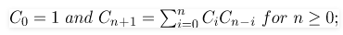
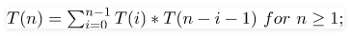
Catalan Number
For example :
C₃ =C₀C₂+C₁C₁+C₂C₀
C₃ =C₀(C₀C₁+C₁C₀)+C₁C₁+(C₀C₁+C₁C₀)C₀
C₃ =1(1+1)+(1)(1)+(1+1)1=5
Conventional approach:
Catalan numbers satisfy the following recursive formula.
Time complexity of above implementation is equivalent to nth catalan number.

Slide 67
Catalan Number
Dynamic Programming:
We can observe that the above recursive implementation does a lot of repeated work (we can the same by drawing recursion tree).
Since there are overlapping subproblems, we can use dynamic programming for this.
Time complexity of implementation of Catalan Number using dynamic programming is O(n²)

Slide 68
Catalan Number
Algorithm using Dynamic Programming:
Instead of returning the result of each iteration (which takes time) we store it in a dynamic array.
We fill the first two elements of the array and iterate using the recursive formula and store it in the dynamic array.
catalan[i] += catalan[j] * catalan[i - j - 1]
At the end of each outer iteration return the value of catalan[n].
In the driver code (main function) we call the Catalan function by passing the given number n.

Slide 69
Euclidean algorithms

Slide 70
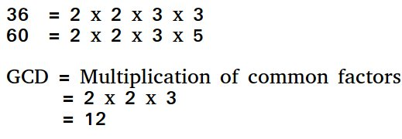
Euclidean algorithms
What is a GCD?
GCD of any two numbers is the largest number that divides both of them.
A simple way to find GCD is to factorize both numbers and multiply common prime factors.

Slide 71
Conventional Approach to compute GCD
The factors of both the numbers are stored in two different arrays.
Then we iterate through the arrays and then search for the common elements.
Then display the greatest of the common elements as GCD

Slide 72
Euclidean algorithms
Basic Euclidean Algorithm for GCD
The algorithm is based on the below facts -
If we subtract a smaller number from a larger (we reduce a larger number), GCD doesn’t change. So if we keep subtracting repeatedly the larger of two, we end up with GCD.
Now instead of subtraction, if we divide the smaller number, the algorithm stops when we find remainder 0.

Slide 73
Longest Common Substring

Slide 74
Longest Common Substring
You are given two input strings A and B. We need to display the length of the longest common substring in A and B
For Example:
Input: A= “abcdwxyz” B=“abcdefg”
Output: 4
Explaination: The common substring is “abcd” whose length is 4.

Slide 75
Longest Common Substring
Conventional approach:
A simple solution is to one by one consider all substrings of first string and for every substring check if it is a substring in second string. Keep track of the maximum length substring.
There will be O(m^2) substrings and we can find whether a string is substring on another string in O(n) time. So overall time complexity of this method would be O(n * m²)

Slide 76
Longest Common Substring
Dynamic Programming:
Dynamic Programming can be used to find the longest common substring in O(m*n) time.
The idea is to find length of the longest common suffix for all substrings of both strings and store these lengths in a table.

Slide 77
Longest Common Substring
Algorithm using Dynamic Programming:
The longest common suffix has following optimal substructure property.
If last characters match, then we reduce both lengths by 1 LCSuff(X, Y, m, n) = LCSuff(X, Y, m-1, n-1) + 1 if X[m-1] = Y[n-1]
If last characters do not match, then result is 0, i.e.,
LCSuff(X, Y, m, n) = 0 if (X[m-1] != Y[n-1])
Now we consider suffixes of different substrings ending at different indexes. The maximum length Longest Common Suffix is the longest common substring. LCSubStr(X, Y, m, n) = Max(LCSuff(X, Y, i, j)) where 1 <= i <= m and 1 <= j <= n

Slide 78
Let’s summarise!
The theory of basic data structures.
The working and application of data structures
Coding the functions for different data structure
Hashing and Collision
Methods to resolve collision in a hash table
Importance of Searching
Searching Algorithms
What is Dynamic Programming?
Different methods used while dynamic programming

Slide 79
Social Media Handles
Facebook Link : https://www.facebook.com/ISTE.VIT/
Instagram Link : https://instagram.com/iste_vit_vellore
YouTube Link : https://www.youtube.com/channel/UCVRlM9S7LDPyo_mwNpBrnXg
LinkedIn Link : https://www.linkedin.com/company/indian-society-for-technical-education
Our Website : https://horizon.istevit.in/
GITHUB : https://github.com/ISTE-VIT

Slide 80
THANK YOU!!

